Slide 1

1
Managing and the Manager’s Job

Slide 2

What Is an Organization?
A group of people working together in a structured and coordinated fashion to achieve a set of goals.
In order to understand management observe the following slide Table 1.1, which is a resource-based perspective, it will provide a view of the four basic kinds of resources required in an organization:

Slide 3
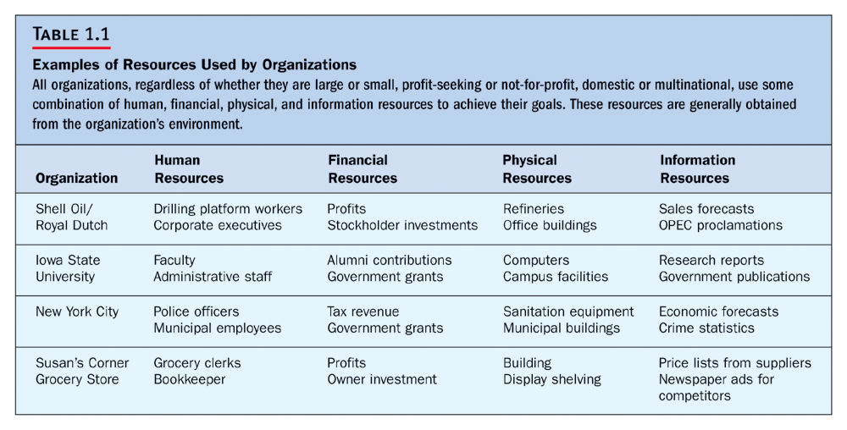

Slide 4
How Do Managers Combine and Coordinate the Various Kinds of Resources?
The following slide Figure 1.1 illustrates how managers combine and coordinate the various kinds of resources:

Slide 5
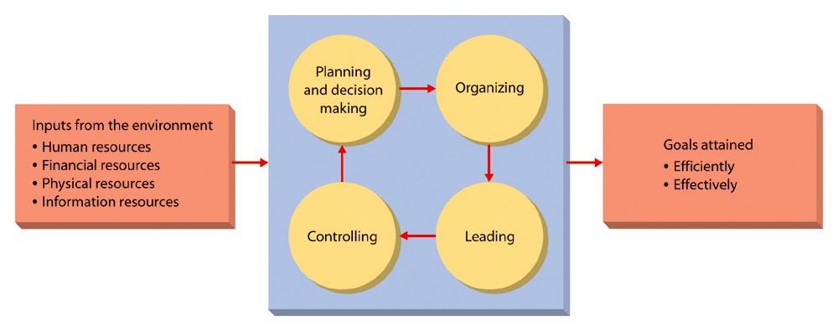
Figure 1.1: Management in Organizations

Slide 6

What Is Management?
A set of activities (including planning and decision making, organizing, leading, and controlling) directed at an organization’s resources (human, financial, physical, and informational) with the aim of achieving organizational goals in an efficient and effective manner.

Slide 7
Who Is the Manager?
College Dean?
Police officer?
Surgeon?
Web-designer?
Football coach?
Chef?
Managing your checking account?

Slide 8
The Manager’s Job Is To:
PLAN:
  A manager cannot operate effectively unless he or she has long range plans.
A plan for each day’s work:
  What is to be done, and why do it?
  When is it to be done, and how will it be done?
  Who is to do the job?
  Where should it be done?

Slide 9
The Manager Must Organize
When there is more than one employee needed to carry out a plan.
Then organization is needed.
A team must be formed.
Each job must be carefully defined in terms of what is to be done.
Establish delegation of responsibility.

Slide 10

The Three Informational Roles
Monitor
Disseminator
Spokesperson

Slide 11
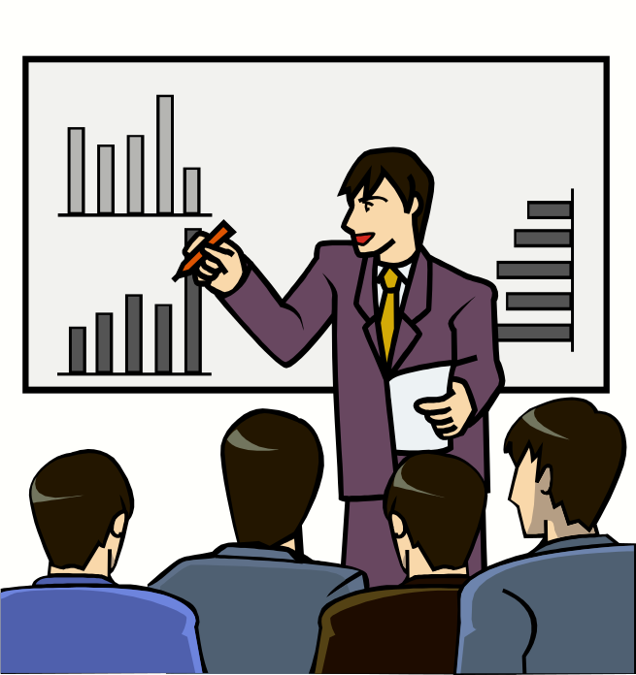
The Manager Must Control
Control means?
A method of checking up to find what has been done and what must be done.
A manager must know how well employees are performing.

Slide 12

The Management Process
Planning and Decision Making
  Setting the organization’s goals and deciding how best to achieve them.
Organizing
  Determining how best to group activities and resources.
Leading
  Motivating members of the organization
Controlling
  Monitoring and correcting activities

Slide 13
The Management Process
The manager’s primary responsibility is to carry out the management process.
Figure 1.2 will illustrate the basic definitions and interrelationships of the basic managerial functions:

Slide 14
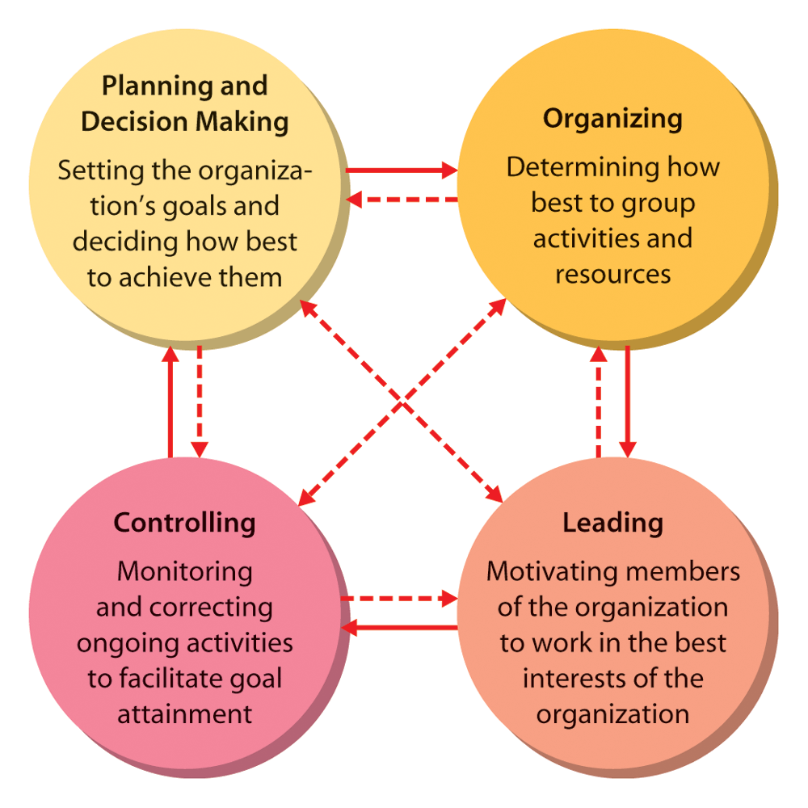
Figure 1.2: The Managerial Process

Slide 15
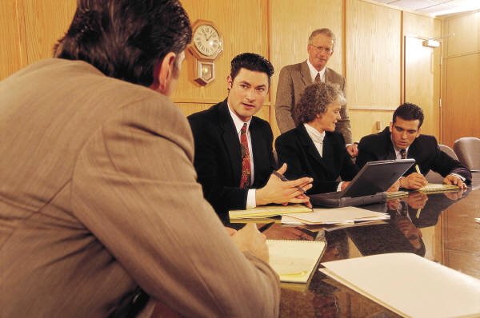
Kinds of Managers
Managing at Different Levels of the organization:
  Top Managers
    Small group of executives who manage the overall organization, the strategic level.
  Middle Managers
    A large group that implement the strategies developed at the top.

Slide 16


Kinds of Managers
First-Line Managers
  Supervise and coordinate the activities of operating employees.

Slide 17
Video: “Effective Management Pilots Southwest Airlines”
The video in the next slide focuses on the important role of middle managers and supervisors at Southwest Airlines.

Slide 18

Video: “Effective Management Pilots Southwest Airlines”

Slide 19
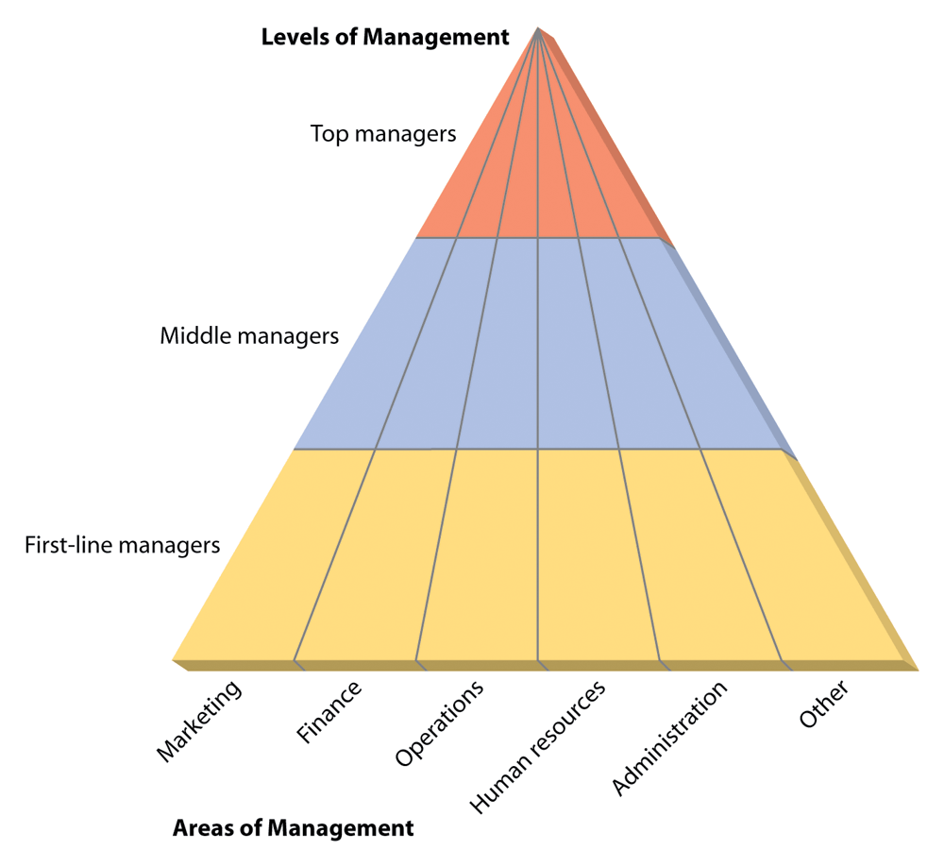
Figure 1.3: Kinds of Managers by
Level and Area

Slide 20

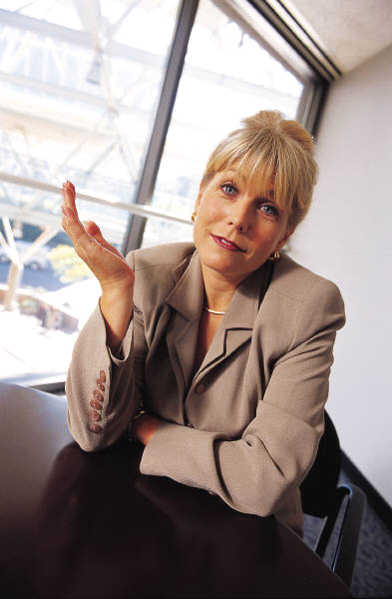
Managing in Different
Areas of the Organization
Marketing Managers
Financial Managers
Operations Managers
Human Resource Managers
Administrative Managers
Specialized Management

Slide 21
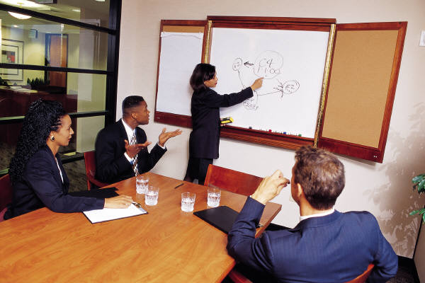
Basic Managerial Roles and Skills
Regardless of level or area within an organization, all managers must play certain roles and exhibit certain skills in order to be successful, such as:
  Do certain things.
  Meet certain needs.
  Have certain responsibilities.

Slide 22
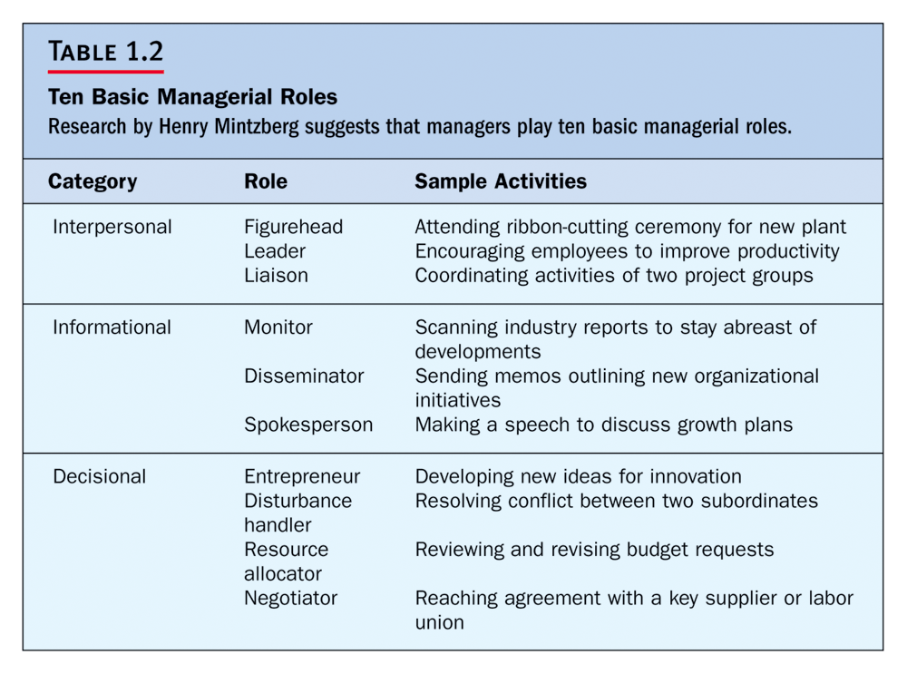

Slide 23
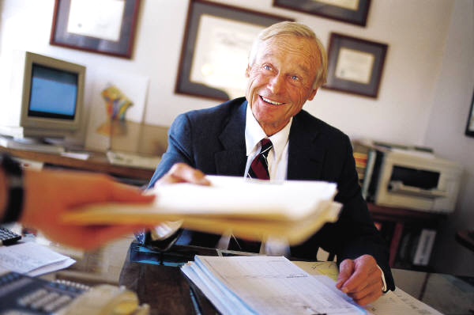
The Three Interpersonal Roles
Figurehead
Leader
Liaison, Coordinator

Slide 24
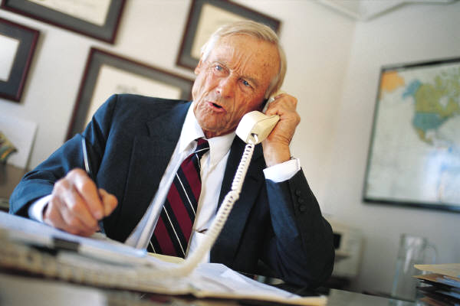
The Four DECISIONAL ROLES
Entrepreneur
Disturbance Handler
Resource Allocator
Negotiator

Slide 25

Managerial Skills
In addition to fulfilling roles, managers also need a number of specific skills.
The most fundamental management skills are:
  Technical
  Interpersonal
  Conceptual
  Diagnostic
  Communication
  Decision-making
  Time-management

Slide 26

Technical Skills
Necessary to accomplish or understand the specific kind of work being done.
These skills are especially important for first line managers.

Slide 27

Interpersonal Skills
The ability to communicate with, understand, and motivate both individuals and groups.
Be able to get along with:
  Subordinates
  Peers
  Those at higher levels

Slide 28

Conceptual Skills
A manager’s ability to think in the abstract.
The mental capacity to:
  Understand organizational goals and its environment.
  How the organization is structured.
  Viewing the organization as system.

Slide 29
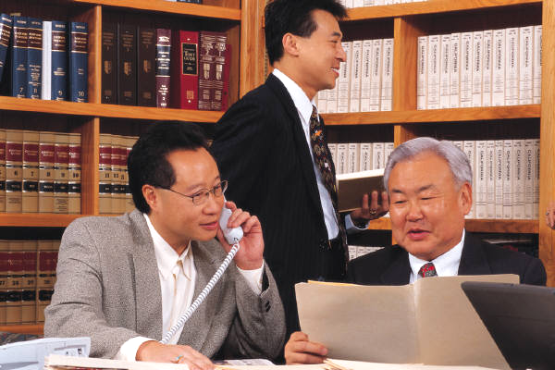
Diagnostic Skills
Skills that enable a manager to visualize the most appropriate response to a situation.

Slide 30

Communication Skills
A manager’s abilities both to effectively convey ideas and information to others and to effectively receive ideas and information from others.

Slide 31

Decision-Making Skills
A manager’s ability to correctly recognize and define problems and opportunities and to then select an appropriate course of action to solve problems and capitalize on opportunities.

Slide 32

Time-Management Skills
The manager’s ability to prioritize work, to work efficiently, and to delegate appropriately.

Slide 33
Becoming a Manager
How does one acquire the skills necessary to blend the science and art of management to become successful manager?
Observe the next slide Figure 1.4, it will become clear how this generally happens:

Slide 34
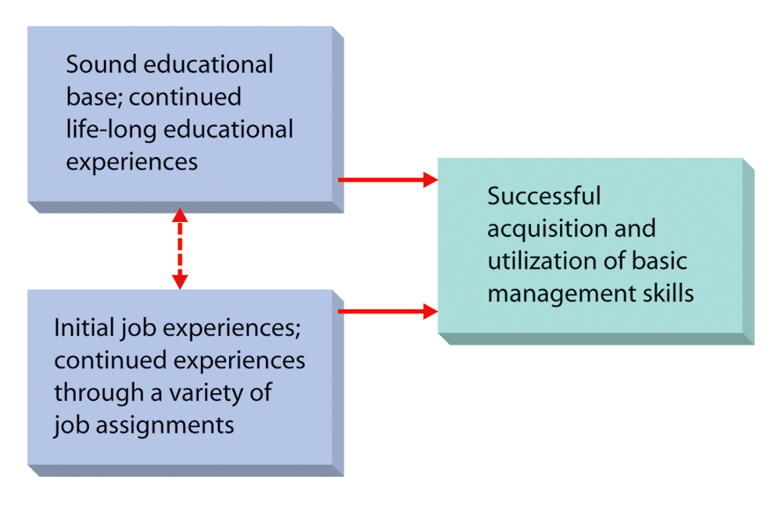
Figure 1.4: Sources of
Management Skills

Slide 35

The Nature of Management
The manager’s job is fraught with:
  Uncertainty
  Change
  Interruption
  Fragmented activities

Slide 36

A Manager Must be a Leader of Employees
It means overseeing the team by influencing the employees to get the job done.
Motivating employees.
Creating an environment that makes employees work efficiently.
Managers get employees to put forth their best effort.

Slide 37
You Have Been Assigned As
Manager of Your Group
The manager whose place you are taking is being left on the job for a period to train you, but he is not training you.
You find the previous manager has been running a one person show.
The morale of the employees really could be better.
What are you going to do?

